Slide 1
iClicker Question
MTV enjoys its success due to its first-move advantage
True
False

Slide 2
iClicker Question
A pitfall of MTV when going global was that they tried to export the "American culture" with their international channels.
True
False

Slide 3
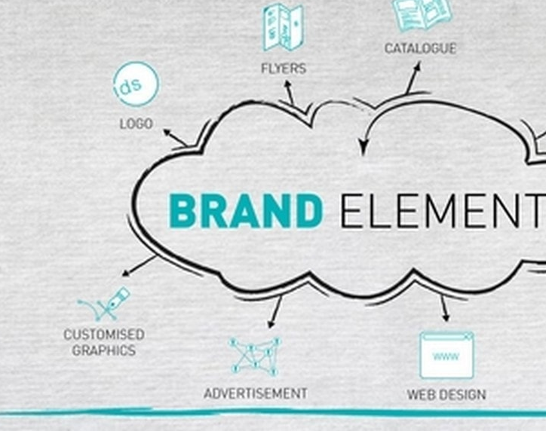
Choosing Brand Elements to Build Brand Equity
Chapter 4

Slide 4
Brand Management Building Blocks
Developing a Brand Strategy
Designing and Implementing Brand Marketing Programs
Measuring and Interpreting Brand Performance
Growing and Sustaining Brand Equity
Notes:
Covered chapters 2-3 under developing a brand strategy
This week we focus on designing and implementing brand marketing programs

Slide 5
Learning Objectives
4.1 Identify the different types of brand elements
4.2 List the general criteria for choosing brand elements
4.3 Describe key tactics in choosing different brand elements
4.4 Explain the rationale for “mixing and matching” brand elements
4.5 Highlight some of the legal issues surrounding brand elements

Slide 6
What are Brand Elements?
Notes:
How to do identify a brand? By?
Trademarkable devices that serve to identify and differentiate the brand
e.g., Brand names, URLs, logos, symbols, spokespeople, slogans, jingles, packages, and signage.
Brand elements should be chosen so that we can
Increase brand awareness
Facilitate the formation of strong, favorable and unique brand associations
Elicit positive brand judgments and feelings

Slide 7

Criteria for Choosing Brand Elements
Memorability
Meaningfulness
Likability
Transferability
Adaptability
Protectability
Offensive Strategy
Defensive Strategy
Notes:
In general, there are six criteria for brand elements:
Memorability: recognized, recalled
Meaningfulness: descriptive, persuasive
General info about the function of the product or service. Related to brand awareness and salience
Specific info about particular attributes and benefits of the brand: related to brand image and positioning.
Likeability: Fun and interesting
Transferability:
Within and across product categories: how useful is the brand elements for lien or category extension? (e.g., Amazon vs. Books “R” Us)
across geographic boundaries and cultures: How well is it translated to other cultures? It depends largely on language as well. (e.g., nonmeaningful, synthetic names Exxon) https://thelanguagenerds.com/2019/product-names-that-mean-something-unfortunate-in-other-languages/
Adaptability: Flexible, Updatable
Protectability: Legally, competitively
The first three criteria—memorability, meaningfulness, and likability—are the marketer’s
offensive strategy and build brand equity. The latter three, however, play a defensive role for
leveraging and maintaining brand equity in the face of different opportunities and constraints. Details of each is offered on the following slide.

Slide 8
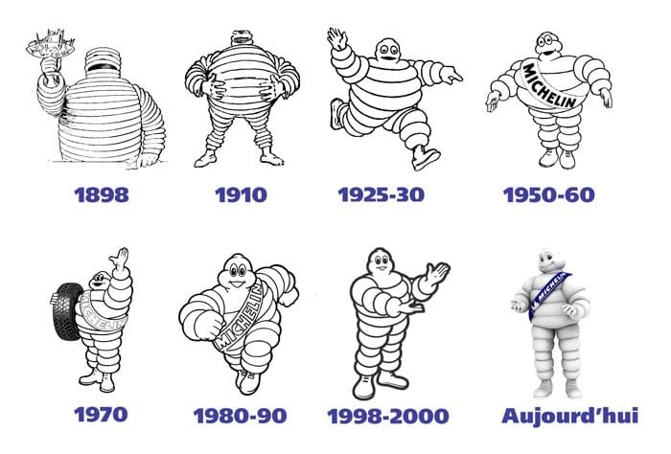
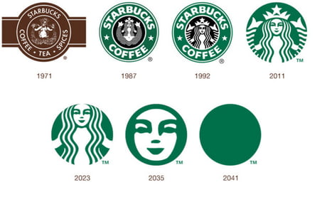
Adaptability

Slide 9

Protectability
Counterfeit:
Good?
Bad?
ML and AI
Help?
Hurt?

Slide 10
Options and Tactics for Brand Elements
What would an ideal brand element be like?
Easily remembered
Highly suggestive of the product class and benefits
Inherently fun or interesting
Rich with creative potential
Transferable to a wide variety of product and geographic settings
Enduring in meaning and relevant over time
Strongly protectable both legally and competitively
Notes:
Unfortunately, it is difficult to choose a brand name—or any brand element, for that matter—that satisfies all these criteria. The more meaningful the brand name, for example, the more difficult it may be to transfer it to new product categories or translate it to other cultures. This is one reason why it’s preferable to have multiple brand elements.

Slide 11
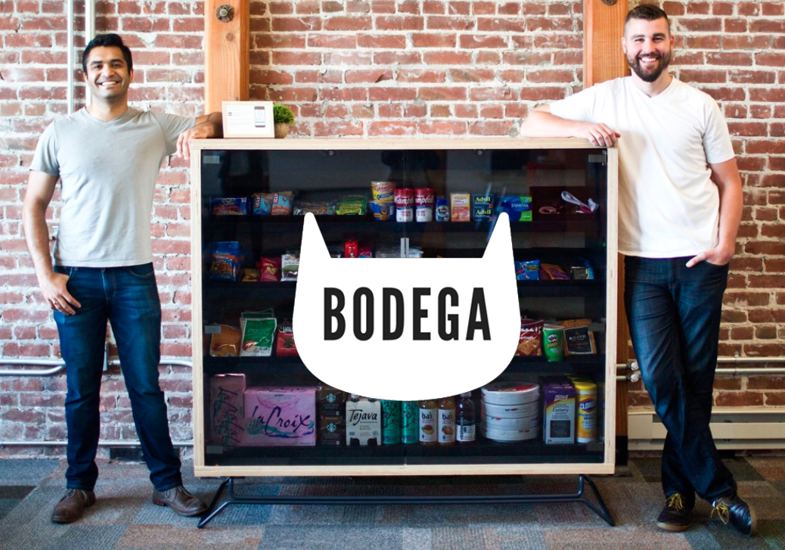
Brand Names
Change can be costly
5-20 % drop in sales
Mistakes sometimes are made
Bodega

Slide 12

Brand Names
Selecting a brand name for a new product is an art and a science
Must be chosen with the six general criteria in mind:
Memorability
Meaningfulness
Likability
Transferability
Adaptability
Protectability

Slide 13

Figure 4-3: Brand Name Taxonomy
Descriptive
Sleep Inn
Evocative
Quicken Loans
Personality
Snapple
Synthetic
Verizon
Founder
Dyson

Slide 14
Brand Names
Brand awareness:
Simple and easy to pronounce or spell
Familiar
Meaningful
Different, distinctive, and unusual
Brand associations:
Implicit and explicit meanings of a name are important
Too pronounced association can be bad
Brand recall
Brand recognition
Notes:
Naming guidelines:
Simplicity and ease of pronunciation and spelling: Consumers will try to avoid embarrassment
Familiarity and meaningfulness
Differentiated, distinctive, and unique
Brand associations:
Morpheme: Smallest linguistic unit having meaning
Plosives: The letters b, c, d, g, k, p, and t
Sibilants: Sounds like s and soft c
Marketers can shorten Chevy, Bud, Coke.

Slide 15
Brand Names
Brand names can reinforce an important attribute or benefit associated that makes up its product positioning
A descriptive brand name should make it easier to link the reinforced attribute or benefit

Slide 16
Tradeoffs
Memorability
Meaningfulness
Transferability
Extendibility

Slide 17
Figure 4-4: Sample Suggestive Brand Names
ColorStay lipsticks
Head & Shoulders shampoo
Close-Up toothpaste
SnackWell reduced fat snacks
DieHard auto batteries
Mop & Glo floor wax
Lean Cuisine low-calorie frozen entrees
Shake’n Bake chicken seasoning
Sub-Zero refrigerators and freezers
Cling-Free static buildup remover
Facebook social network
Dropbox cloud storage

Slide 18
Brand Names - Naming procedures
Define objectives
Generate names
Screen initial candidates
Study candidate names
Research the final candidates
Select the final name
Notes:
Unintentional double meaning
Unpronounceable, already in use, too close to an existing name
Previous legal complications
represents an obvious contradiction of the positioning.

Slide 19
U R Ls (1 of 2)
U R Ls (uniform resource locators) specify locations of pages on the Web:
Commonly referred to as domain names
Owner of a U R L must register and pay for the name
Protects a brand from unauthorized use in other domain names
Cybersquatting- Registering, trafficking in, or using a domain name with bad-faith to profit from:
The goodwill of a trademark belonging to someone else

Slide 20
U R Ls (2 of 2)
A company needs to protect their brands from unauthorized use in other domain names:
Company can:
Sue current owner of the U R L for copyright infringement
Buy the name from the current owner
Register all conceivable variations of its brand as domain names ahead of time
Cybersquatting or domain squatting:
Registering, trafficking in, or using a domain name with bad-faith to profit from:
The goodwill of a trademark belonging to someone else
Notes:
An issue facing companies with regard to URLs is protecting their brands from unauthorized use in other domain names. A company can sue the current owner of the URL for copyright infringement, buy the name from the current owner, or register all conceivable variations of its brand as domain names ahead of time.
Cybersquatting has recently morphed into another type of deceptive practice called spoofing—a practice in which scam artists set up fraudulent sites which use variants of a brand’s name to set up a series of URLs in order to attract unsuspecting actors and encourage them to spend money. These sorts of fraudulent sites is said to be worth $460 billion annually, which is much larger than the stated size of the personal $264 billion that eMarketer estimated is the value of the online personal luxury goods market in 2016.

Slide 21


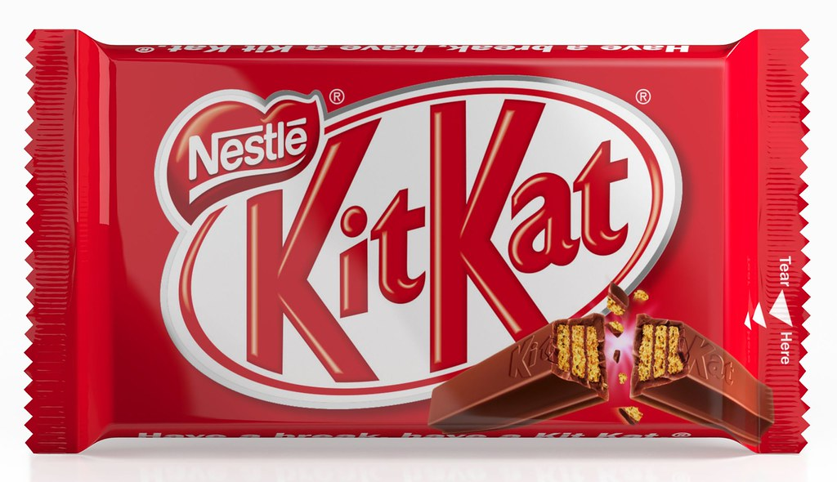
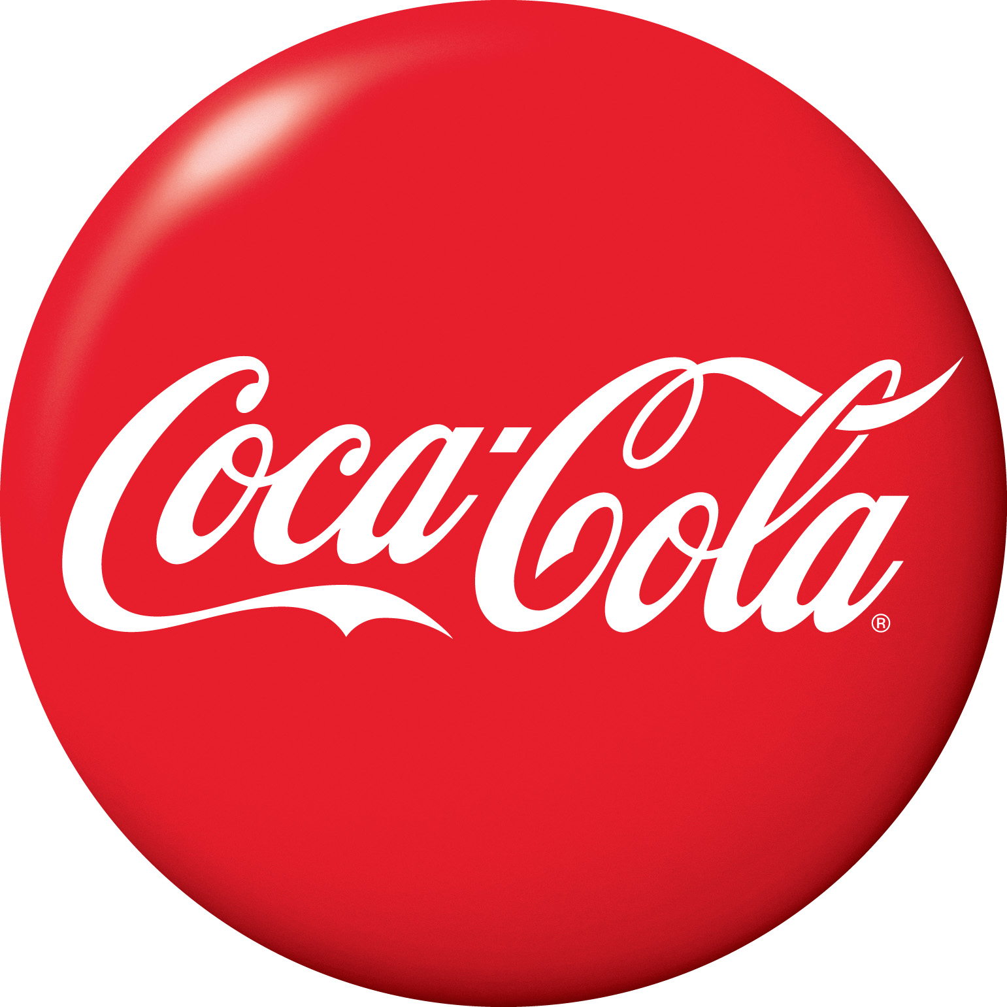
Logos and Symbols (1 of 2)
Logos:
Visual elements play a critical role in building brand equity and brand awareness:
Indicate origin, ownership, or association
Range from corporate names or trademarks written in a distinctive form, to abstract designs that may:
Be completely unrelated to the corporate name or activities
Symbols:
Nonword mark logos
This Photo by Unknown Author is licensed under CC BY-NC-ND
This Photo by Unknown Author is licensed under CC BY-SA-NC
This Photo by Unknown Author is licensed under CC BY-NC-ND
Notes:
Examples of brands with strong word marks and no accompanying logo separate from the name include Coca-Cola, Dunhill, and Kit Kat.
Examples of abstract logos include the Mercedes star, Rolex crown, CBS eye, Nike swoosh, and Olympic rings. These nonword mark logos are also often called symbols.

Slide 22
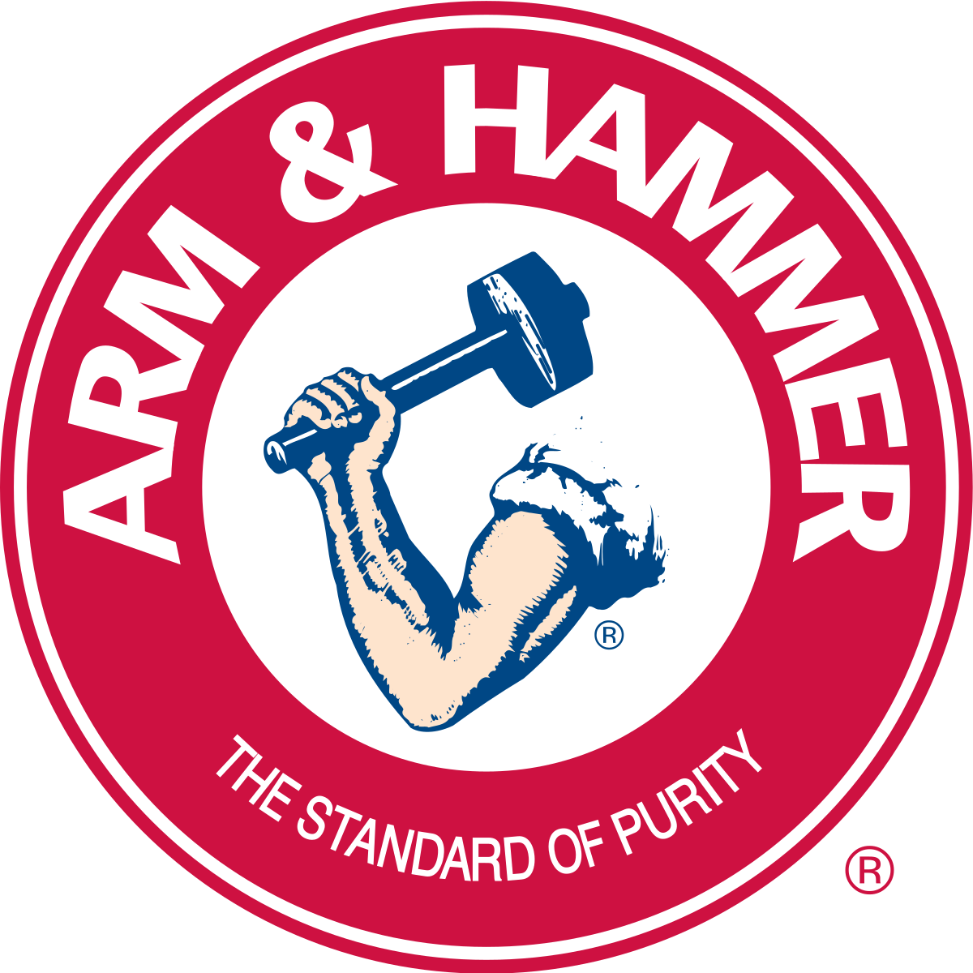

In between logos and symbols
This Photo by Unknown Author is licensed under CC BY
This Photo by Unknown Author is licensed under CC BY-SA

Slide 23
Logos and Symbols (2 of 2)
Like names, abstract logos can be distinctive and recognizable:
Abstract logos may lack the inherent meaning present with a more concrete logo
One danger is that consumers may not understand what the logo is intended to represent
Notes:
Benefits:
Easily recognizable
Valuable as a way to identify products
Versatile
Abstract logos offer advantages when the full brand name is difficult to use
Unlike brand names, logos can be easily adapted over time
For a more contemporary look
Talk about brand elements as well

Slide 24
Common Themes in Top Logos
Nearly half of all logos use a single color
A third used either red or blue
23 percent used black and white
More than half of all logos featured a horizonal aspect ratio
A logo change usually cost ~ 1$ mil

Slide 25

Characters
Special type of brand symbol:
One that takes on human or real-life characteristics
Introduced through advertising:
Can play a central role in ad campaigns and package designs
Notes:
Benefits:
Tend to be attention getting and quite useful for creating brand awareness.
Help brands break through marketplace clutter as well as help communicate a key product benefit.
The human element of brand characters can enhance likeability and help create perceptions of the brand as fun and interesting.
A consumer may more easily form a relationship with a brand when the brand literally has a human or other character presence.
Brand characters do not typically have direct product meaning, therefore they can be transferred relatively easily across product categories.
Cautions:
Can be so attention getting and well liked that they dominate other brand elements and actually dampen brand awareness.
Must be updated over time so that their image and personality remain relevant to the target market.

Slide 26
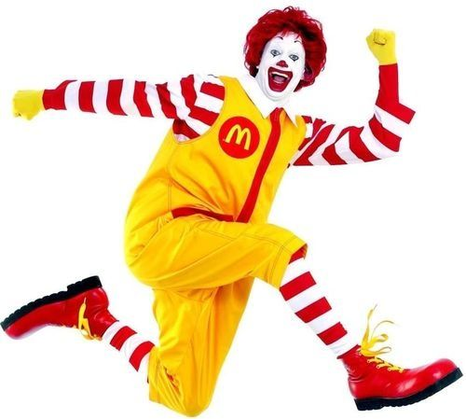
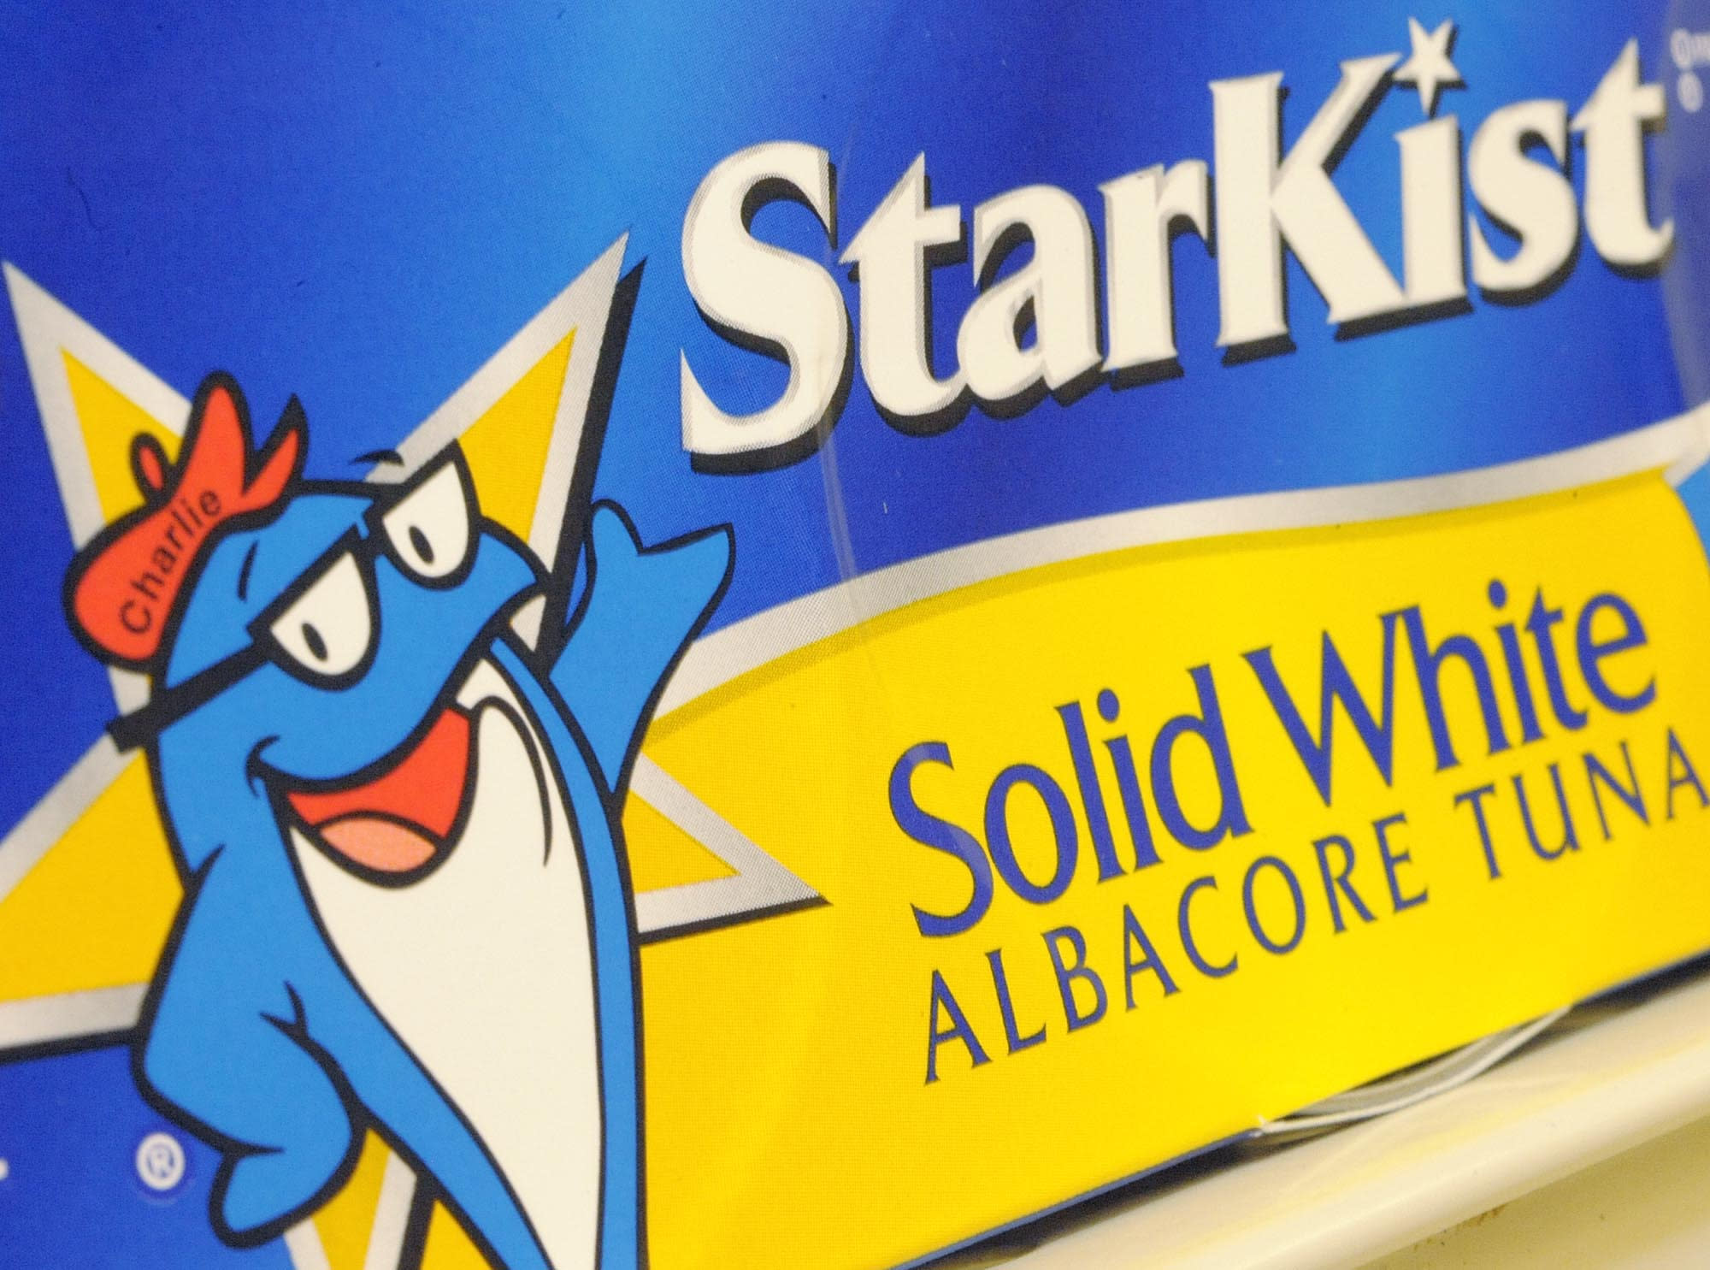
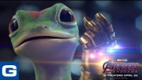
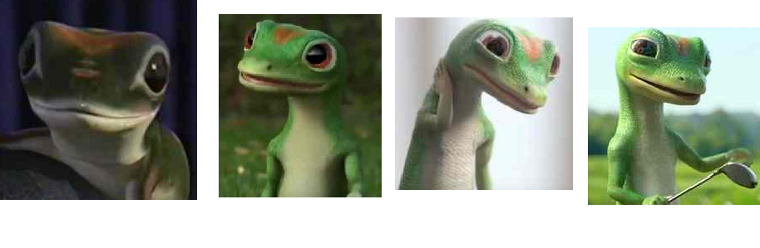
Character Examples
Notes:
Starkist’s charlile

Slide 27
Slogans (1 of 2)
Short phrases that communicate descriptive or persuasive information about the brand
Function as useful “hooks” or “handles” to help consumers grasp the meaning of a brand
Indispensable means of summarizing and translating the intent of a marketing program
Notes:
Benefits:
Help build brand awareness by making strong links between the brand and the corresponding product category.
May serve as tag lines to summarize the descriptive or persuasive information conveyed in the ads.

Slide 28
Slogans (2 of 2)
Designing slogans:
Designed so they contribute to brand equity in multiple ways
Can contain product-related messages and other meanings
Updating slogans:
Recognize how it contributes to brand equity:
Through enhanced awareness or image
Decide how much of this equity enhancement, if any, is still needed
Retain needed or desired equities still residing in the slogan
While providing whatever new twists of meaning are necessary to contribute to equity in other ways

Slide 29
Figure 4-7: Famous Slogans Quiz (1 of 2)
Have It Your Way
Just Do It
When It Absolutely, Positively Has to Be There Overnight
Drivers Wanted
Don’t Leave Home Without It
Like a Rock
Because I’m Worth It
Notes:
2) Burger King;
(3) Nike;
(4) Federal Express;
(5) Volkswagen;
(6) American Express;
(7) Chevrolet;
(8) L’Oreal;

Slide 30
Figure 4-7: Famous Slogans Quiz (2 of 2)
The Ultimate Driving Machine
When You Care Enough to Send the Very Best
Capitalist Tool
No More Tears
Melts in Your Mouth, Not in Your Hands
Where Do You Want to Go Today?
Fly the Friendly Skies
Notes:
(9) B M W;
(10) Hallmark;
(11) Forbes magazine;
(13) Johnson’s Baby Shampoo;
(14) M&M’s
(17) Microsoft; (20) United Airlines.

Slide 31
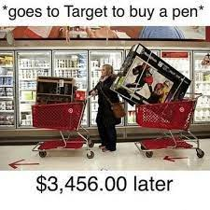
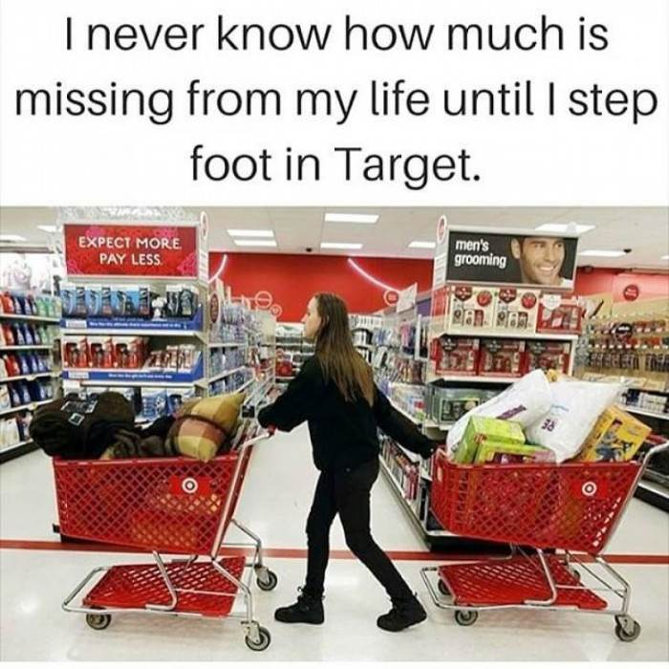
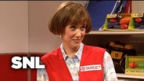
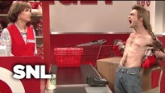
Target
Notes:
Target’s next innovative moves:
Partner with TikTok influencer, advertise on Waze, have snack and drink stand
Target should not partner with Amazon. Why?

Slide 32

Group Discussion
Brand Positioning

Slide 33

Jingles
Musical messages written around the brand
Catchy hooks and choruses:
Become permanently registered in the minds of listeners
Enhance brand awareness by repeating the brand name in clever and amusing ways
Notes:
We can think of jingles as extended musical slogans, and in that sense classify them as a brand element. Because of their musical nature, however, jingles are not nearly as transferable as other brand elements. They can communicate brand benefits, but they often convey product meaning in a nondirect and fairly abstract fashion. Thus, the potential associations they might create for the brand are most likely to relate to feelings and personality and other intangibles.

Slide 34
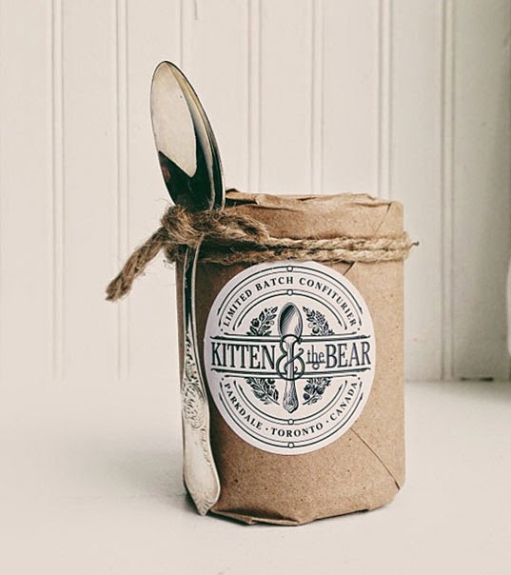
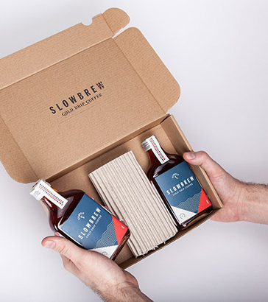
Benefits of Packaging
This Photo by Unknown Author is licensed under CC BY-SA-NC
This Photo by Unknown Author is licensed under CC BY-SA-NC

Slide 35
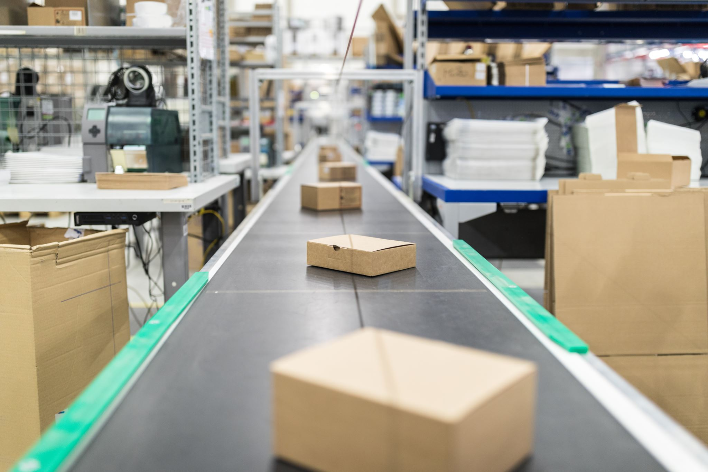
Packaging (1 of 4)
Activity of designing and producing containers or wrappers
From the perspective of both the firm and consumers, packaging must:
Identify the brand
Convey descriptive and persuasive information
Facilitate product transportation and protection
Assist in at-home storage
Aid product consumption
Notes:
Benefits:
Structural packaging innovations can create a point of difference that permits a higher margin.
New packages can also expand a market and capture new market segments.
Packaging changes can have immediate impact on customer shopping behavior and sales.

Slide 36

Packaging (2 of 4)
Packaging at the point of purchase:
The right packaging can create strong appeal:
On the store shelf
Help products stand out from the clutter
Can provide at least a temporary edge on competition
Packaging innovations:
Can lower costs
Can improve demand for a product
Notes:
Packaging at the point of purchase:
Many consumers may first encounter a new brand on the supermarket shelf or in the store; therefore right packaging can create strong appeal on the store shelf and help products stand out from the clutter.
When few product differences exist in some categories, packaging innovations can provide at least a temporary edge on competition.
Packaging innovations:
Can both lower costs and/or improve demand
Manufacturers can redesign packages and employ more recyclable materials to lower the use of paper and plastic.
In mature markets, package innovations can provide a short-term sales boost.

Slide 37

Packaging (3 of 4)
Package design:
Has become a more sophisticated process:
Specialized package designers bring artistic techniques and scientific skills
Refers to “shelf impact” of a package
Notes:
Package designing:
Integral part of product development and launch.
Specialized package designers bring artistic techniques and scientific skills to package design in an attempt to meet the marketing objectives for a brand.
Packaging color affect consumers’ perceptions of the product itself.

Slide 38

Packaging (4 of 4)
Packaging changes:
Can be expensive:
But can be cost-effective compared with other marketing communication costs:
Signal a higher price, or to more effectively sell products through new or shifting distribution channels
When a significant product line expansion would benefit from a common look
To accompany a new product innovation to signal changes to consumers
When old package looks outdated
Notes:
Packaging changes:
Firms change their packaging:
To signal a higher price, or to more effectively sell products through new or shifting distribution channels.
When a significant product line expansion would benefit from a common look.
To accompany a new product innovation to signal changes to consumers.
When the old package looks outdated.

Slide 39
Putting It All Together
Each brand element can play a different role in building brand equity:
Marketers “mix and match” to maximize brand equity
Brand identity:
Entire set of brand elements
Contribution of all brand elements to awareness and image
Notes:
Meaningful brand names that are visually represented through logos are easier to remember with than without such reinforcement. The cohesiveness of the brand identity depends on the extent to which the brand elements are consistent. Ideally, marketers choose each element to support the others and all can be easily incorporated into other aspects of the brand and the marketing program.

Slide 40
Figure 4-8: Critique of Brand Element Options
Criterion | Brand Names and U R Ls | Logos and Symbols | Characters | Slogans and Jingles | Packaging and Signage
Memorability | Can be chosen to enhance brand recall and recognition | Generally more useful for brand recognition | Generally more useful for brand recognition | Can be chosen to enhance brand recall and recognition | Generally more useful for brand recognition
Meaningfulness | Can reinforce almost any type of association, although sometimes only indirectly | Can reinforce almost any type of association, although sometimes only indirectly | Generally more useful for non-product-related imagery and brand personality | Can convey almost any type of association explicitly | Can convey almost any type of association explicitly
Likability | Can evoke much verbal imagery | Can provoke visual appeal | Can generate human qualities | Can evoke much verbal imagery | Can combine visual and verbal appeal
Transferability | Can be somewhat limited | Excellent | Can be somewhat limited | Can be somewhat limited | Good
Adaptability | Difficult | Can typically be redesigned | Can sometimes be redesigned | Can be modified | Can typically be redesigned
Protectability | Generally good, but with limits | Excellent | Excellent | Excellent | Can be closely copied

